Slide 1
BRIDGEPORT HOSPITAL (BC & MC)
ANATOMIC PATHOLOGY
QUALITY ASSURANCE MEETING
February 28, 2024
for the Month of January 2024

Slide 2
OLD BUSINESS
\\Ynhh.org\src\BH - Laboratory\AP - BH 38030\! AP QA\AP QA Meetings\2024\2024 AGENDA & MEETING MINUTES\February 21, 2024\minutes for month of December held on January 23rd 2024.docx

Slide 3
Surgical Specimens Volume OCTOBER 2023- January 2024

Slide 4
BRIDGEPORT CAMPUS
Intraoperative Diagnosis vs. Final/ Amendments & Histology):
\\Ynhh.org\src\BH - Laboratory\AP - BH 38030\! AP QA\AP QA Meetings\2024\2024 AGENDA & MEETING MINUTES\February 21, 2024\ANATOMIC QA 2 28 2024.docx
\\Ynhh.org\src\BH - Laboratory\AP - BH 38030\! AP QA\AP QA Meetings\2024\2024 Consensus Conference\January 2024 Consensus Conference.pdf

Slide 5
Milford Campus January 2024 Frozen Stats
-Frozen: 0 - Parts that Meet Threshold: 0
-Blocks: 0
-Touch Preps: 0 -% of Parts that Meets Threshold: 0% -Cases: 0
Threshold of 20 min./ block – only one case met the 20 minutes threshold
Number of discrepancies: 0

Slide 6
Non-Gyn Case Volume & TAT ≤ 5 Days

Slide 7
SYSTEM QUALITY METRIC
FY24

Slide 8
Prostate TAT (received to sign out) % <=5 business days (track)

Slide 9
GI Biopsy TAT 80% </= 2 business days (received to sign out)

Slide 10
Breast Biopsy TAT 80% </= 2 business days (received to sign out)

Slide 11
Lung TAT (received to sign out) 90% <= 2 business days

Slide 12
CYTOLOGY SPECIMENS
SENT TO YSM FOR PROCESSING

Slide 13
Non-Gyn Cytology TAT 75% </= 2 business days (received to sign out) exclude any case with cell block

Slide 14
Cytology GYN TAT with ancillary testing 75% in </= 5 business days & Cytology GYN TAT no HPV 75% in </= 4 business days

Slide 15
Contaminant/Floater/Extraneous
TISSUE

Slide 16
Contaminants by Month 1/31/2023-1/31/2024
2 of 2,000 cases (0.01%)
2 of 8,617 blocks (0.02%)
2 of 16,818 slides (0.01%)
Benign
Malignant
Benchmark: 1.5% of cases, 0.8% of blocks, 0.6% of slides. Gephardt GN, Zarbo RJ. Extraneous tissue in surgical pathology: a College of American Pathologists Q-Probes study of 275 laboratories. Arch Pathol Lab Med 1996 Nov; 120(11):1009-14.
* Microtomy

Slide 17
Contaminants/ Floaters Bridgeport Hospital

Slide 18
Type of Floater & Site of Contamination January 2024
TISSUE | TISSUE | MAIL | MALIGNANT | PHOTO | ON | PROX | FLOATER | SAME CASE | DIFFERENT CASE
PATIENT | FLOATER | EMAIL |  | EMAIL | LEVELS | REP | ORIGIN
L3 Vertebral Fracture | Placenta | No | No | No | Yes | Yes | Tissue Processor | No | Yes
Esophagus | Colon | No | No | No | Yes | Yes | Grossing | No | Yes

Slide 19
92 CONTAMINANTS IN BLOCKS (01/01/2020- 1/31/2024)

Slide 20
Tissue Processor Verification
\\Ynhh.org\bh\Laboratory\AP - BH 38030\! AP QA\AP QA Meetings\2024\2024 Tissue Processor Check\1. January Tissue Processor Check.pdf

Slide 21
5 Monthly Internal Audits
\\Ynhh.org\bh\Laboratory\AP - BH 38030\! AP QA\AP QA Meetings\2024\2024 Audit Cases\January 2024 Audit Cases.pdf

Slide 22
Challenges and Opportunities for Improvement Anatomic Pathology (Before Final Dx)

Slide 23
Histology Processing Issues

Slide 24
Histology Processing Issues

Slide 25
Notes:
Combined volume for May 459. Error rate is 0.22%

Slide 26
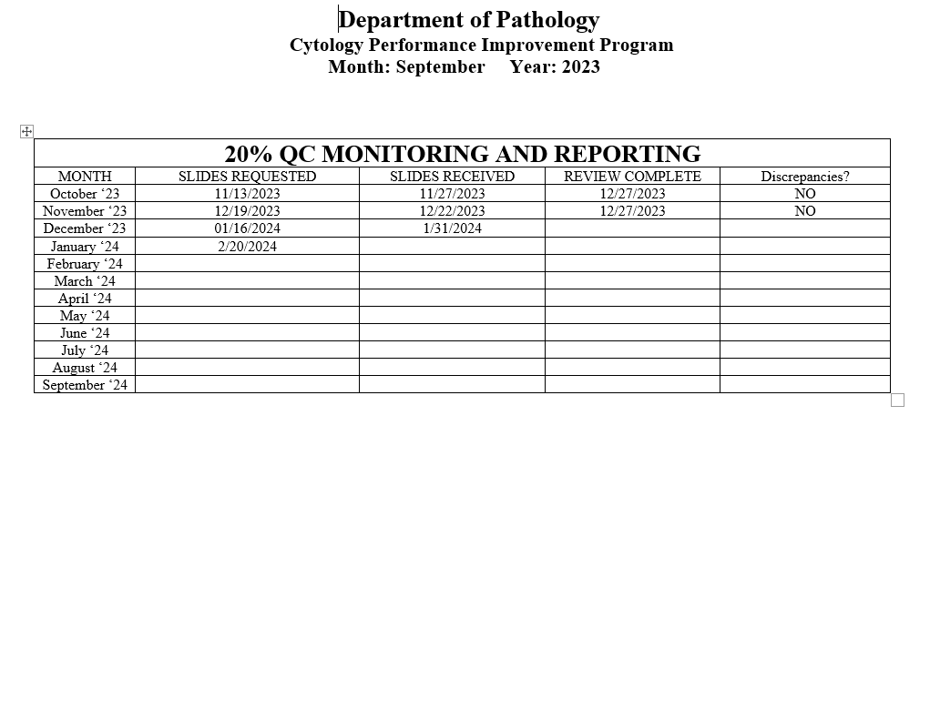
Notes:
The NON GYN TAT is due to staffing issues at YSM, extended leaves, vacations, and cross training in processing. May impact June.
We are up to date on QC review, April and May are with Dr. Cohen. We’ve had no discrepancies.

Slide 27
Competency Checklist
\\Ynhh.org\src\BH - Laboratory\AP - BH 38030\! AP QA\AP QA Meetings\COMPETENCY LOG TO UPDATE MONTHLY\Monthly Competency.xlsx

Slide 28
Reports:
Policy and Procedures for signature Review (ongoing)
Ongoing...
PM for all other equipment
\\Ynhh.org\bh\Laboratory\AP - BH 38030\Maintenance & Service Reports\Current Instrument List.xlsx

Slide 29
Non-Conforming Events
\\Ynhh.org\src\BH - Laboratory\AP - BH 38030\! AP QA\AP QA Meetings\Irreplaceable Specimen Templates\IS Update for BH goals 2024 presentations\IS Update for BH goals month of January 2024.pptx

Slide 30
New Business
SAFER event for AP- None for January
Equipment: Tissue Processor- Peloris & embedding station- Arcadia
Personnel Update
Pathology Candidate
Students (HTL, PA)
Cytology
Recognition

